Slide 1
CS 425 / ECE 428
Distributed Systems
Fall 2014
Indranil Gupta (Indy)
Lecture 9-10: Peer-to-peer Systems
All slides © IG

Slide 2
Why Study Peer to Peer Systems?
First distributed systems that seriously focused on scalability with respect to number of nodes
P2P techniques abound in cloud computing systems
  Key-value stores (e.g., Cassandra, Riak, Voldemort) use Chord p2p hashing

Slide 3
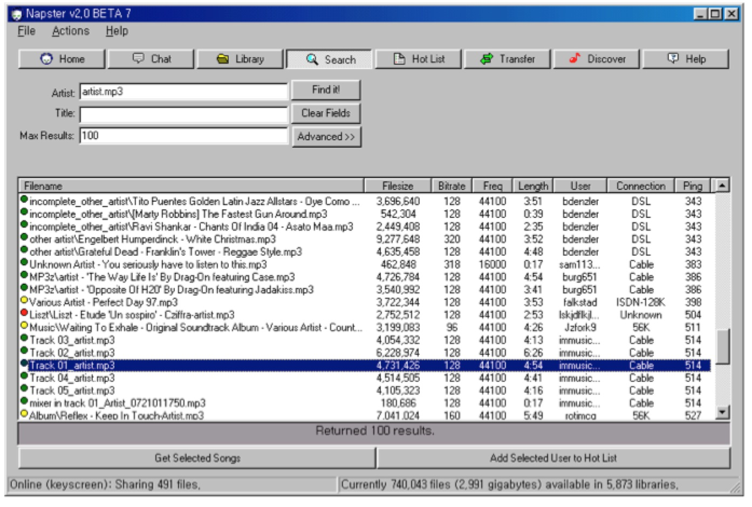
Why Study Peer to Peer Systems?

Slide 4
A Brief History
[6/99] Shawn Fanning (freshman Northeastern U.) releases Napster online music service
[12/99] RIAA sues Napster, asking $100K per download
[3/00] 25% UWisc traffic Napster, many universities ban it
[00] 60M users
[2/01] US Federal Appeals Court: users violating copyright laws, Napster is abetting this
[9/01] Napster decides to run paid service, pay % to songwriters and music companies
[Today] Napster protocol is open, people free to develop opennap clients and servers http://opennap.sourceforge.net
  Gnutella: http://www.limewire.com (deprecated)
  Peer to peer working groups: http://p2p.internet2.edu

Slide 5
What We Will Study
Widely-deployed P2P Systems
  Napster
  Gnutella
  Fasttrack (Kazaa, Kazaalite, Grokster)
  BitTorrent
P2P Systems with Provable Properties
  Chord
  Pastry
  Kelips

Slide 6
Napster Structure
Filename Info about
Store a directory, i.e.,
filenames with peer pointers
PennyLane.mp3 Beatles, @
128.84.92.23:1006
…..
napster.com Servers
S
S
Client machines
(“Peers”)
S
P
P
P
P
P
P
Store their own
files

Slide 7
Napster Operations
Client
Connect to a Napster server
  Upload list of music files that you want to share
  Server maintains list of <filename, ip_address, portnum> tuples. Server stores no files.

Slide 8
Napster Operations
Client (contd.)
Search
  Send server keywords to search with
  (Server searches its list with the keywords)
  Server returns a list of hosts - <ip_address, portnum> tuples - to client
  Client pings each host in the list to find transfer rates
  Client fetches file from best host
All communication uses TCP (Transmission Control Protocol)
  Reliable and ordered networking protocol

Slide 9
Napster Search
2. All servers search their lists (ternary tree algorithm)
Store peer pointers
for all files
napster.com Servers
S
S
Client machines
(“Peers”)
1. Query
S
P
3. Response
P
4. ping candidates
P
P
P
P
Store their own
files
5. download from best host

Slide 10
Joining a P2P system
Can be used for any p2p system
  Send an http request to well-known url for that P2P service - http://www.myp2pservice.com
  Message routed (after lookup in DNS=Domain Name system) to introducer, a well known server that keeps track of some recently joined nodes in p2p system
  Introducer initializes new peers’ neighbor table

Slide 11
Problems
Centralized server a source of congestion
Centralized server single point of failure
No security: plaintext messages and passwds
napster.com declared to be responsible for users’ copyright violation
  “Indirect infringement”
  Next system: Gnutella

Slide 12
Gnutella
Eliminate the servers
Client machines search and retrieve amongst themselves
Clients act as servers too, called servents
[3/00] release by AOL, immediately withdrawn, but 88K users by 3/03
Original design underwent several modifications

Slide 13
Gnutella
Store their own
files
Servents (“Peers”)
P
P
P
Also store
“peer pointers”
P
P
P
P
Connected in an overlay graph
(== each link is an implicit Internet path)

Slide 14
How do I search for my Beatles file?
Gnutella routes different messages within the overlay graph
Gnutella protocol has 5 main message types
  Query (search)
  QueryHit (response to query)
  Ping (to probe network for other peers)
  Pong (reply to ping, contains address of another peer)
  Push (used to initiate file transfer)
We’ll go into the message structure and protocol now
  All fields except IP address are in little-endian format
  Ox12345678 stored as 0x78 in lowest address byte, then 0x56 in next higher address, and so on.

Slide 15
How do I search for my Beatles file?
Descriptor Header
Payload
Descriptor ID Payload descriptor TTL Hops Payload length
0 15 16 17 18 22
Number of bytes of
message following
this header
Type of payload
0x00 Ping
0x01 Pong
0x40 Push
0x80 Query
0x81 Queryhit
ID of this
search
transaction
Decremented at each hop,
Message dropped when ttl=0
ttl_initial usually 7 to 10
Incremented at each hop
Gnutella Message Header Format

Slide 16
How do I search for my Beatles file?
Query (0x80)
Minimum Speed Search criteria (keywords)
0 1 …..
Payload Format in Gnutella Query Message

Slide 17


Gnutella Search
Query’s flooded out, ttl-restricted, forwarded only once
P
P
P
P
TTL=2
P
P
P
Who has PennyLane.mp3?

Slide 18
Gnutella Search
QueryHit (0x81) : successful result to a query
Num. hits port ip_address speed (fileindex,filename,fsize) servent_id
0 1 3 7 11 n n+16
Results
Info about
responder
Unique identifier of responder;
a function of its IP address
Payload Format in Gnutella QueryHit Message

Slide 19
Gnutella Search
Successful results QueryHit’s routed on reverse path
P
P
P
P
P
P
P
Who has PennyLane.mp3?

Slide 20
Avoiding excessive traffic
To avoid duplicate transmissions, each peer maintains a list of recently received messages
Query forwarded to all neighbors except peer from which received
Each Query (identified by DescriptorID) forwarded only once
QueryHit routed back only to peer from which Query received with same DescriptorID
Duplicates with same DescriptorID and Payload descriptor (msg type, e.g., Query) are dropped
QueryHit with DescriptorID for which Query not seen is dropped

Slide 21
After receiving QueryHit messages
Requestor chooses “best” QueryHit responder
  Initiates HTTP request directly to responder’s ip+port
  GET /get/<File Index>/<File Name>/HTTP/1.0\r\n
  Connection: Keep-Alive\r\n
  Range: bytes=0-\r\n
  User-Agent: Gnutella\r\n
  \r\n
Responder then replies with file packets after this message:
  HTTP 200 OK\r\n
  Server: Gnutella\r\n
  Content-type:application/binary\r\n
  Content-length: 1024 \r\n
  \r\n

Slide 22
After receiving QueryHit messages (2)
HTTP is the file transfer protocol. Why?
  Because it’s standard, well-debugged, and widely used.
Why the “range” field in the GET request?
  To support partial file transfers.
What if responder is behind firewall that disallows incoming connections?

Slide 23
Dealing with Firewalls
Requestor sends Push to responder asking for file transfer
P
P
P
Has PennyLane.mp3
But behind firewall
P
P
P
P

Slide 24
Dealing with Firewalls
Push (0x40)
servent_id fileindex ip_address port
same as in
received QueryHit
Address at which
requestor can accept
incoming connections

Slide 25
Dealing with Firewalls
Responder establishes a TCP connection at ip_address, port specified. Sends
  GIV <File Index>:<Servent Identifier>/<File Name>\n\n
Requestor then sends GET to responder (as before) and file is transferred as explained earlier
What if requestor is behind firewall too?
  Gnutella gives up
  Can you think of an alternative solution?

Slide 26
Ping-Pong
Ping (0x00)
no payload
Peers initiate Ping’s periodically
Pings flooded out like Querys, Pongs routed along reverse path like QueryHits
Pong replies used to update set of neighboring peers
  to keep neighbor lists fresh in spite of peers joining, leaving and failing
Pong (0x01)
Port ip_address Num. files shared Num. KB shared

Slide 27

Gnutella Summary
No servers
Peers/servents maintain “neighbors”, this forms an overlay graph
Peers store their own files
Queries flooded out, ttl restricted
QueryHit (replies) reverse path routed
Supports file transfer through firewalls
Periodic Ping-pong to continuously refresh neighbor lists
  List size specified by user at peer : heterogeneity means some peers may have more neighbors
  Gnutella found to follow power law distribution:
  P(#links = L) ~ (k is a constant)

Slide 28
Problems
Ping/Pong constituted 50% traffic
  Solution: Multiplex, cache and reduce frequency of pings/pongs
Repeated searches with same keywords
  Solution: Cache Query, QueryHit messages
Modem-connected hosts do not have enough bandwidth for passing Gnutella traffic
  Solution: use a central server to act as proxy for such peers
  Another solution:
    ➔FastTrack System (soon)

Slide 29
Problems (contd.)
Large number of freeloaders
  70% of users in 2000 were freeloaders
  Only download files, never upload own files
Flooding causes excessive traffic
  Is there some way of maintaining meta-information about peers that leads to more intelligent routing?
  ➔ Structured Peer-to-peer systems
  e.g., Chord System (coming up next lecture)

Slide 30
FastTrack
Hybrid between Gnutella and Napster
Takes advantage of “healthier” participants in the system
Underlying technology in Kazaa, KazaaLite, Grokster
Proprietary protocol, but some details available
Like Gnutella, but with some peers designated as supernodes

Slide 31
A FastTrack-like System
Peers
P
P
P
S
P
S
P
Supernodes

Slide 32
FastTrack (contd.)
A supernode stores a directory listing a subset of nearby (<filename,peer pointer>), similar to Napster servers
Supernode membership changes over time
Any peer can become (and stay) a supernode, provided it has earned enough reputation
  Kazaalite: participation level (=reputation) of a user between 0 and 1000, initially 10, then affected by length of periods of connectivity and total number of uploads
  More sophisticated Reputation schemes invented, especially based on economics (See P2PEcon workshop)
A peer searches by contacting a nearby supernode

Slide 33
Announcements
Tech Talk today by Nutanix
Illini Union @ 4pm. Company does virtualization (700+ employees). Has lots of openings for next year!
MP1 due this Sunday
Registration waitlist closed. Everyone ought to have been able to register by now (you should have received email from the department last week).

Slide 34
DHT=Distributed Hash Table
A hash table allows you to insert, lookup and delete objects with keys
A distributed hash table allows you to do the same in a distributed setting (objects=files)
Performance Concerns:
  Load balancing
  Fault-tolerance
  Efficiency of lookups and inserts
  Locality
Napster, Gnutella, FastTrack are all DHTs (sort of)
So is Chord, a structured peer to peer system that we study next

Slide 35
Comparative Performance
 | Memory | Lookup Latency | #Messages for a lookup
Napster | O(1) (O(N)@server) | O(1) | O(1)
Gnutella | O(N) | O(N) | O(N)

Slide 36
Comparative Performance
 | Memory | Lookup Latency | #Messages for a lookup
Napster | O(1) (O(N)@server) | O(1) | O(1)
Gnutella | O(N) | O(N) | O(N)
Chord | O(log(N)) | O(log(N)) | O(log(N))

Slide 37


Chord
Developers: I. Stoica, D. Karger, F. Kaashoek, H. Balakrishnan, R. Morris, Berkeley and MIT
Intelligent choice of neighbors to reduce latency and message cost of routing (lookups/inserts)
Uses Consistent Hashing on node’s (peer’s) address
  SHA-1(ip_address,port) →160 bit string
  Truncated to m bits
  Called peer id (number between 0 and )
  Not unique but id conflicts very unlikely
  Can then map peers to one of logical points on a circle

Slide 38
Ring of peers
Say m=7
0
6 nodes
N112
N16
N96
N32
N80
N45

Slide 39
Peer pointers (1): successors
Say m=7
0
N112
N16
N96
N32
N80
N45
(similarly predecessors)

Slide 40
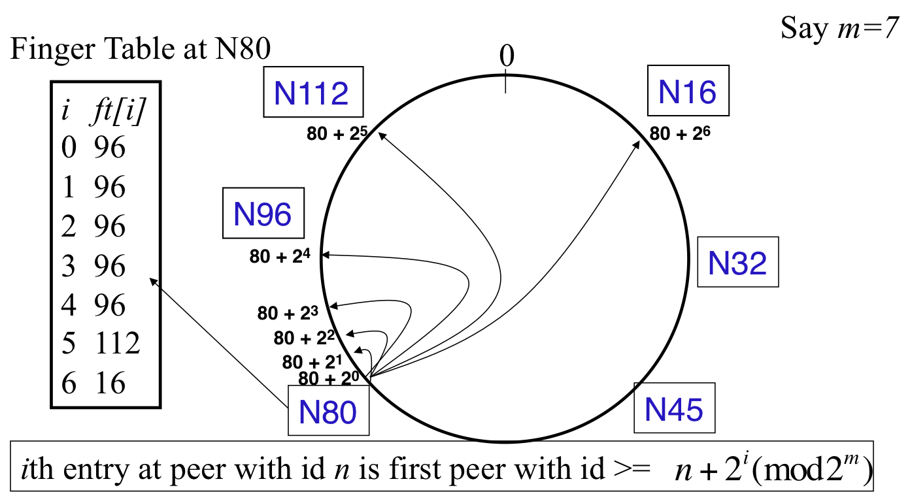
Peer pointers (2): finger tables

Slide 41

What about the files?
Filenames also mapped using same consistent hash function
  SHA-1(filename) →160 bit string (key)
  File is stored at first peer with id greater than or equal to its key (mod )
File cnn.com/index.html that maps to key K42 is stored at first peer with id greater than 42
  Note that we are considering a different file-sharing application here : cooperative web caching
  The same discussion applies to any other file sharing application, including that of mp3 files.
Consistent Hashing => with K keys and N peers, each peer stores O(K/N) keys. (i.e., < c.K/N, for some constant c)
Slide corrected after lecture

Slide 42
Mapping Files
Say m=7
0
N112
N16
N96
N32
N80
N45
File with key K42
stored here

Slide 43
Search
Say m=7
0
N112
N16
N96
Who has cnn.com/index.html?
(hashes to K42)
N32
N80
N45
File cnn.com/index.html with
key K42 stored here

Slide 44

Search
At node n, send query for key k to largest successor/finger entry <= k
if none exist, send query to successor(n)
At or to the anti-clockwise of k
(it wraps around the ring)
0
N112
N16
Say m=7
N96
Who has cnn.com/index.html?
(hashes to K42)
N32
N80
N45
File cnn.com/index.html with
key K42 stored here

Slide 45
Search
At node n, send query for key k to largest successor/finger entry <= k
if none exist, send query to successor(n)
0
N112
N16
Say m=7
All “arrows” are RPCs
(remote procedure calls)
N96
Who has cnn.com/index.html?
(hashes to K42)
N32
N80
N45
File cnn.com/index.html with
key K42 stored here

Slide 46

Analysis
Here
Search takes O(log(N)) time
  Proof
  (intuition): at each step, distance between query and peer-with-file reduces by a factor of at least 2
  (intuition): after log(N) forwardings, distance to key is at most
  Number of node identifiers in a range of
  is O(log(N)) with high probability (why? SHA-1! and “Balls and Bins”)
  So using successors in that range will be ok, using another O(log(N)) hops
Next hop
Key

Slide 47
Analysis (contd.)
O(log(N)) search time holds for file insertions too (in general for routing to any key)
  “Routing” can thus be used as a building block for
    All operations: insert, lookup, delete
O(log(N)) time true only if finger and successor entries correct
When might these entries be wrong?
  When you have failures

Slide 48
Search under peer failures
Lookup fails
(N16 does not know N45)
Say m=7
0
N112
N16
N96
X
X
Who has cnn.com/index.html?
(hashes to K42)
N32
X
N80
N45
File cnn.com/index.html with
key K42 stored here

Slide 49
Search under peer failures
Say m=7
One solution: maintain r multiple successor entries
In case of failure, use successor entries
0
N112
N16
N96
X
Who has cnn.com/index.html?
(hashes to K42)
N32
N80
N45
File cnn.com/index.html with
key K42 stored here

Slide 50
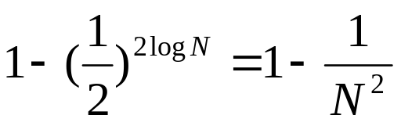
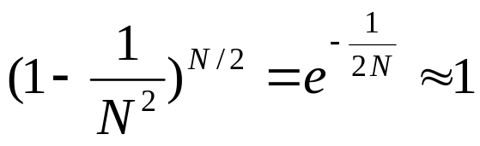
Search under peer failures
Choosing r=2log(N) suffices to maintain lookup correctness w.h.p.(i.e., ring connected)
  Say 50% of nodes fail
  Pr(at given node, at least one successor alive)=
  Pr(above is true at all alive nodes)=

Slide 51
Search under peer failures (2)
Say m=7
Lookup fails
(N45 is dead)
0
N112
N16
N96
Who has cnn.com/index.html?
(hashes to K42)
N32
X
X
N80
N45
File cnn.com/index.html with
key K42 stored here

Slide 52
Search under peer failures (2)
Say m=7
One solution: replicate file/key at r successors and predecessors
0
N112
N16
N96
Who has cnn.com/index.html?
(hashes to K42)
N32
K42 replicated
X
N80
N45
File cnn.com/index.html with
key K42 stored here
K42 replicated

Slide 53
Need to deal with dynamic changes
Peers fail
New peers join
Peers leave
  P2P systems have a high rate of churn (node join, leave and failure)
    25% per hour in Overnet (eDonkey)
    100% per hour in Gnutella
    Lower in managed clusters
    Common feature in all distributed systems, including wide-area (e.g., PlanetLab), clusters (e.g., Emulab), clouds (e.g., AWS), etc.
So, all the time, need to:
→ Need to update successors and fingers, and copy keys

Slide 54
New peers joining
Introducer directs N40 to N45 (and N32)
N32 updates successor to N40
N40 initializes successor to N45, and inits fingers from it
N40 periodically talks to neighbors to update finger table
Say m=7
0
N112
N16
Stabilization
Protocol
(followed by
all nodes)
N96
N32
N40
N80
N45

Slide 55
New peers joining (2)
N40 may need to copy some files/keys from N45
(files with fileid between 32 and 40)
Say m=7
0
N112
N16
N96
N32
N40
N80
N45
K34,K38

Slide 56
New peers joining (3)
A new peer affects O(log(N)) other finger entries in the system, on average [Why?]
Number of messages per peer join= O(log(N)*log(N))
Similar set of operations for dealing with peers leaving
  For dealing with failures, also need failure detectors (we’ll see these later in the course!)

Slide 57

Stabilization Protocol
Concurrent peer joins, leaves, failures might cause loopiness of pointers, and failure of lookups
  Chord peers periodically run a stabilization algorithm that checks and updates pointers and keys
  Ensures non-loopiness of fingers, eventual success of lookups and O(log(N)) lookups w.h.p.
  Each stabilization round at a peer involves a constant number of messages
  Strong stability takes stabilization rounds
  For more see [TechReport on Chord webpage]

Slide 58
Churn
When nodes are constantly joining, leaving, failing
  Significant effect to consider: traces from the Overnet system show hourly peer turnover rates (churn) could be 25-100% of total number of nodes in system
  Leads to excessive (unnecessary) key copying (remember that keys are replicated)
  Stabilization algorithm may need to consume more bandwidth to keep up
  Main issue is that files are replicated, while it might be sufficient to replicate only meta information about files
  Alternatives
    Introduce a level of indirection (any p2p system)
    Replicate metadata more, e.g., Kelips (later in this lecture)

Slide 59
Virtual Nodes
Hash can get non-uniform ➔ Bad load balancing
  Treat each node as multiple virtual nodes behaving independently
  Each joins the system
  Reduces variance of load imbalance

Slide 60
Wrap-up Notes
Virtual Ring and Consistent Hashing used in Cassandra, Riak, Voldemort, DynamoDB, and other key-value stores
Current status of Chord project:
  File systems (CFS,Ivy) built on top of Chord
  DNS lookup service built on top of Chord
  Internet Indirection Infrastructure (I3) project at UCB
  Spawned research on many interesting issues about p2p systems
  http://www.pdos.lcs.mit.edu/chord/

Slide 61
Pastry
Designed by Anthony Rowstron (Microsoft Research) and Peter Druschel (Rice University)
Assigns ids to nodes, just like Chord (using a virtual ring)
Leaf Set - Each node knows its successor(s) and predecessor(s)

Slide 62
Pastry Neighbors
Routing tables based prefix matching
  Think of a hypercube
Routing is thus based on prefix matching, and is thus log(N)
  And hops are short (in the underlying network)

Slide 63
Pastry Routing
Consider a peer with id 01110100101. It maintains a neighbor peer with an id matching each of the following prefixes:
  0*
  01*
  011*
  … 0111010010*
When it needs to route to a peer, say 01110111001, it starts by forwarding to a neighbor with the largest matching prefix, i.e., 011101*

Slide 64
Pastry Locality
For each prefix, say 011*, among all potential neighbors with the matching prefix, the neighbor with the shortest round-trip-time is selected
Since shorter prefixes have many more candidates (spread out throughout the Internet), the neighbors for shorter prefixes are likely to be closer than the neighbors for longer prefixes
Thus, in the prefix routing, early hops are short and later hops are longer
Yet overall “stretch”, compared to direct Internet path, stays short

Slide 65
Summary of Chord and Pastry
Chord and Pastry protocols
  More structured than Gnutella
  Black box lookup algorithms
  Churn handling can get complex
  O(log(N)) memory and lookup cost
    O(log(N)) lookup hops may be high
    Can we reduce the number of hops?

Slide 66
Kelips – A 1 hop Lookup DHT
k “affinity groups”
  k ~ √ N
Each node hashed to a group (hash mod k)
Node’s neighbors
  (Almost) all other nodes in its own affinity group
  One contact node per foreign affinity group
15
76
18
160
129
167
30
…
# 1
Affinity
Group # 0
# k-1

Slide 67
Kelips Files and Metadata
File can be stored at any (few) node(s)
Decouple file replication/location (outside Kelips) from file querying (in Kelips)
Each filename hashed to a group
  All nodes in the group replicate pointer information, i.e., <filename, file location>
  Spread using gossip
  Affinity group does not store files
PennyLane.mp3 hashes to k-1
Everyone in this group stores
<PennyLane.mp3, who-has-file>
15
76
18
160
129
167
30
# 1
…
Affinity Group # 0
# k-1

Slide 68
Kelips Lookup
Lookup
  Find file affinity group
  Go to your contact for the file affinity group
  Failing that try another of your neighbors to find a contact
Lookup = 1 hop (or a few)
  Memory cost O(√ N)
    1.93 MB for 100K nodes, 10M files
    Fits in RAM of most workstations/laptops today (COTS machines)
PennyLane.mp3 hashes to k-1
Everyone in this group stores
<PennyLane.mp3, who-has-file>
15
76
18
160
129
167
30
# 1
…
Affinity Group # 0
# k-1

Slide 69
Kelips Soft State
Membership lists
  Gossip-based membership
  Within each affinity group
  And also across affinity groups
  O(log(N)) dissemination time
File metadata
  Needs to be periodically refreshed from source node
  Times out
PennyLane.mp3 hashes to k-1
Everyone in this group stores
<PennyLane.mp3, who-has-file>
15
76
18
160
129
167
30
…
# 1
Affinity Group # 0
# k-1

Slide 70
Chord vs. Pastry vs. Kelips
Range of tradeoffs available
  Memory vs. lookup cost vs. background bandwidth (to keep neighbors fresh)

Slide 71
BitTorrent
Website links to
.torrent
Tracker, per file
(keeps track of some peers;
receives
heartbeats, joins
and leaves
from peers)
1. Get tracker
2. Get peers
Peer
(seed,
has full file)
Peer
3. Get file blocks
(new, leecher)
Peer
Peer
(leecher,
has some blocks)
(seed)

Slide 72
BitTorrent (2)
File split into blocks (32 KB – 256 KB)
Download Local Rarest First block policy: prefer early download of blocks that are least replicated among neighbors
  Exception: New node allowed to pick one random neighbor: helps in bootstrapping
Tit for tat bandwidth usage: Provide blocks to neighbors that provided it the best download rates
  Incentive for nodes to provide good download rates
  Seeds do the same too
Choking: Limit number of neighbors to which concurrent uploads <= a number (5), i.e., the “best” neighbors
  Everyone else choked
  Periodically re-evaluate this set (e.g., every 10 s)
  Optimistic unchoke: periodically (e.g., ~30 s), unchoke a random neigbhor – helps keep unchoked set fresh

Slide 73
What We Have Studied
Widely-deployed P2P Systems
  Napster
  Gnutella
  Fasttrack (Kazaa, Kazaalite, Grokster)
  BitTorrent
P2P Systems with Provable Properties
  Chord
  Pastry
  Kelips

